Slide 1
Software Product Management
Course Introduction
Prof. Dr. Dirk Riehle
Friedrich-Alexander University Erlangen-Nürnberg
PROD A01
Licensed under CC BY 4.0 International
Notes:
It is Friedrich-Alexander University Erlangen-Nürnberg – FAU, in short.
Corporate identity wants us to say “Friedrich-Alexander University”.

Slide 2
Product Management
Software product management is the management of a company’s software products [along the product life-cycle] [across the product portfolio]. [DR]

Slide 3
Course Learning Goals
Students will gain a conceptual understanding of
  software product management
    In both strategic and technical product management
    For the whole life-cycle of a product
    Across a product portfolio
  By preparing teaching cases for class

Slide 4
The (Teaching) Case Method (Recap)
The (Harvard Business School) Case Method is an example-based classroom teaching method used to teach concepts and practices applicable to complex real-world scenarios.
Students prepare for and discuss in class “the case”, a (mostly) realistic representation (10-20 page paper) of a particular situation that a decision maker faced in some context (typically a company).
The case lays out the pros and cons of a difficult decision making situation without suggesting a particular solution; it is up to the students to come up with an opinion and defend it in class.
The case method is suitable for content-to-learn that cannot be easily captured as simple formulas; it aims at complex real-world scenarios, not complicated algorithmic problems.
More information and PM by Case cases available at https://wp.me/Pe4V6-1sW

Slide 5
Skills Required for Course
Basic understanding of
  Business in general
  Software industry in particular
Strong analytical skills

Slide 6
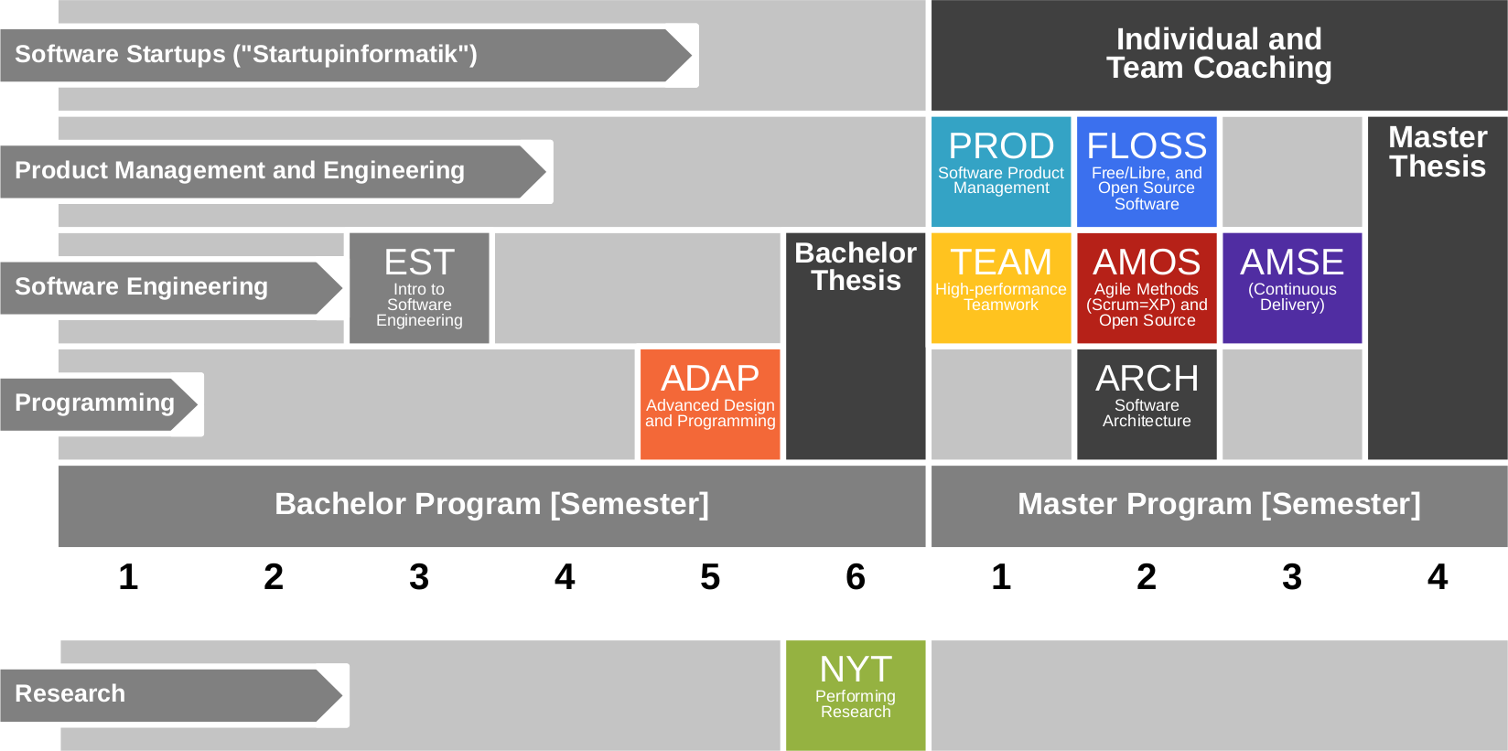
Course Position in Curriculum

Slide 7
Courses and Modules
 |  | Courses (Lehrveranstaltungen)
 |  | OSS-PROD- VUE | OSS-PROD-PROJ | Total ECTS
Modules | OSS-PROD- VUE | x | – | 5
 | OSS-PROD- PROJ | – | x | 5
 | OSS-PROD-VUE+PROJ | x | x | 10
NYT can be taken as
  5 ECTS VL + UE
  5 ECTS Seminar
  10 ECTS VL + UE
  10 ECTS Project
In various degree programs
Also as a Schlüsselqualifikation
VUE = Lecture + exercise (Vorlesung + Übung)
PROJ = Project

Slide 8


Slide 9
Requirement for Passing Course
At least 50% participation in all grade-relevant components
  Class participation
  Case analyses

Slide 10
Course Grading [1]
Class participation (2 SWS) = 30 / 150 = 20%
  Graded using [0|1|2|3] scheme
Case analyses = 120 / 150 = 80%
  Weekly homework = ¾ of component grade
    Graded using [0..10] scheme
  Review of other students’ homework = ¼ of component grade
    Graded using [0|1|2|3] scheme
[1] Also see http://osr.cs.fau.de/teaching/course-resources/grading-schemes-and-scales/

Slide 11
Class Participation
Showing up +
listening to the lecturer +
thinking about what you are hearing +
verbalizing your thoughts (speaking up) +
answering to someone else's thoughts +
collaborating to solve a problem +
adequate use of air-time

Slide 12
Grading Rubric for Teaching Cases
Categories | Points |  |  |  |  | Criteria
 | Disagree | Disagree some | Neutral | Agree some | Agree
Form (10%) | Does the deliverable meet formal requirements? |  |  |  |  | Does the deliverable meet page length requirements, has the right language, has required header, etc.?
Language (10%) | Is the language clear, concise, and helpful? |  |  |  |  | Are sentences complete, is the grammar correct, are statements coherent, etc.?
Structure (30%) | Does the deliverable have a clear logical structure? |  |  |  |  | Does the deliverable reviews alternatives, makes recommendation, argues for it, etc.?
Analysis (50%) | Is the recommendation clear and well supported? |  |  |  |  | As a reference, use your own deliverable as well as what you learned in class.

Slide 13
You Should Not Take This Course, If
Your English is poor
You can’t write precisely
You overloaded on courses

Slide 14

No Oral or Written Exam [1]
[1] You still have to register for the course

Slide 15
Course Language [1]
Class
  Lecture: English
  Student: Choice of German or English
Homework
  Submissions: Choice of German or English
  Reviews: Choice of German or English
[1] http://osr.cs.fau.de/2012/03/10/english-or-german-deutsch-oder-englisch/

Slide 16

Course Communication
Announcements by email (through StudOn)
Questions and answers using FSI Forum for course
If you must send email, use the teaching team alias from course index

Slide 17
Course Information
Course index
  https://goo.gl/Dl6tAe
Course materials
  Cases: https://wp.me/Pe4V6-1sW
  Concepts: See StudOn

Slide 18
Thank you! Questions?
dirk.riehle@fau.de – http://osr.cs.fau.de
dirk@riehle.org – http://dirkriehle.com – @dirkriehle
DR

Slide 19
Credits and License
Original version
  © 2012-2018 Dirk Riehle, some rights reserved
  Licensed under Creative Commons Attribution 4.0 International License
Contributions
  ...

